Slide 1
Graph Neural Networks (GNNs) to Optimize Telecommunications Networks
Oscar Llorente Gonzalez - Senior Data Scientist
Ericsson Cognitive Labs – Geometric Artificial Intelligence (GAI) Lab
February 2025

Slide 2

Who we are
https://ericsson.github.io/cognitive-labs/

Slide 3
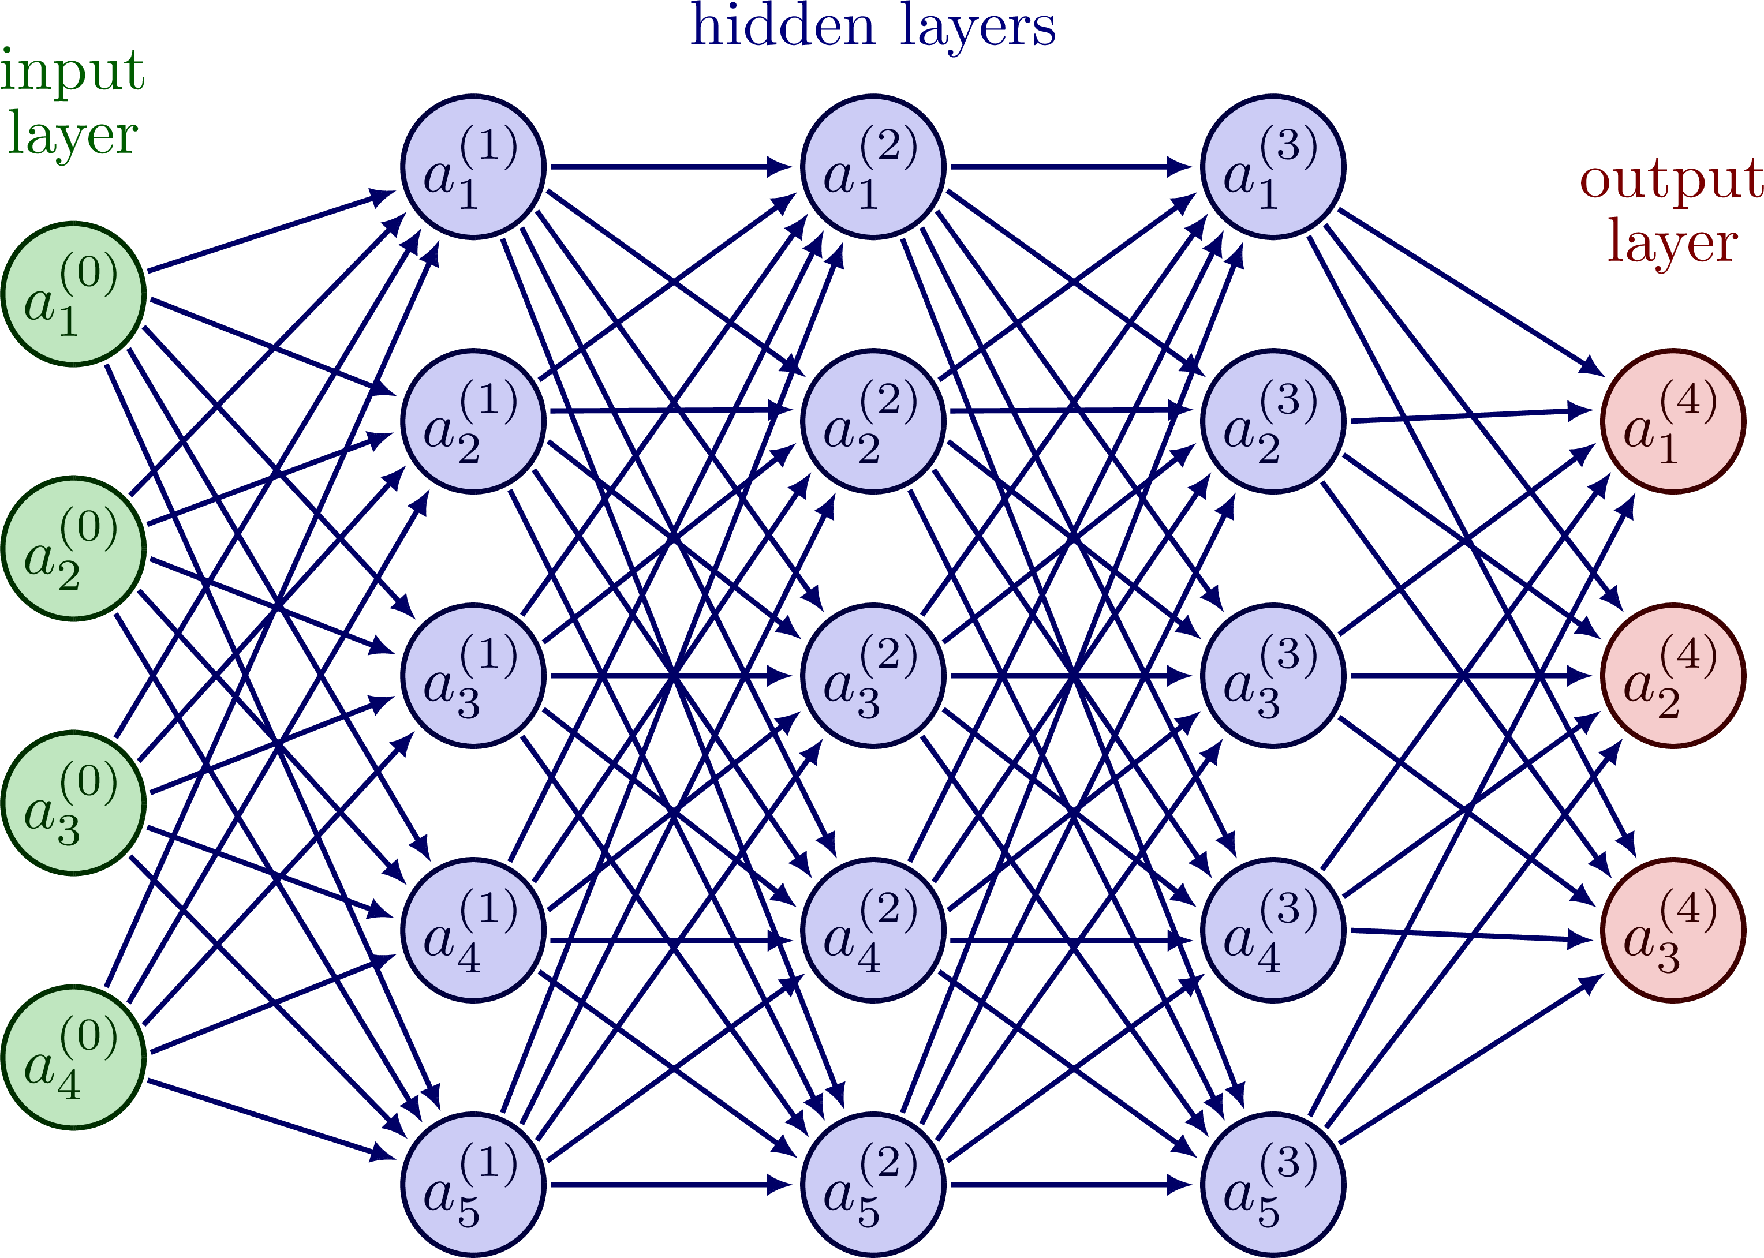
Classical Neural Networks

Slide 4
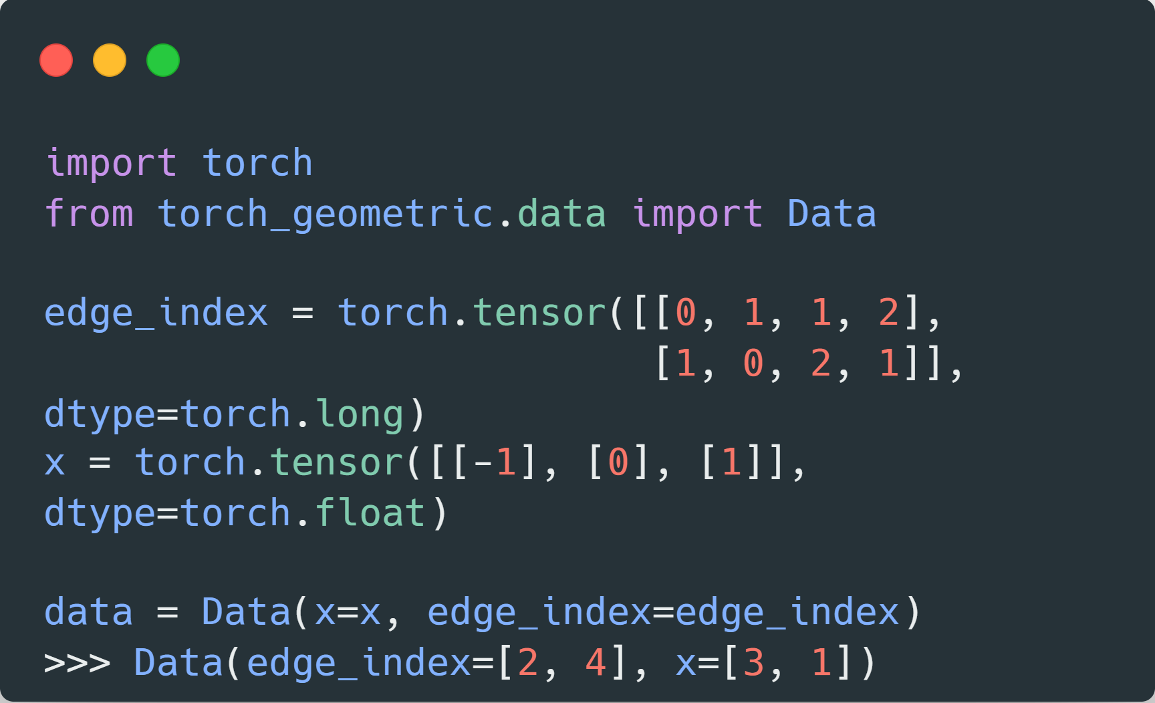
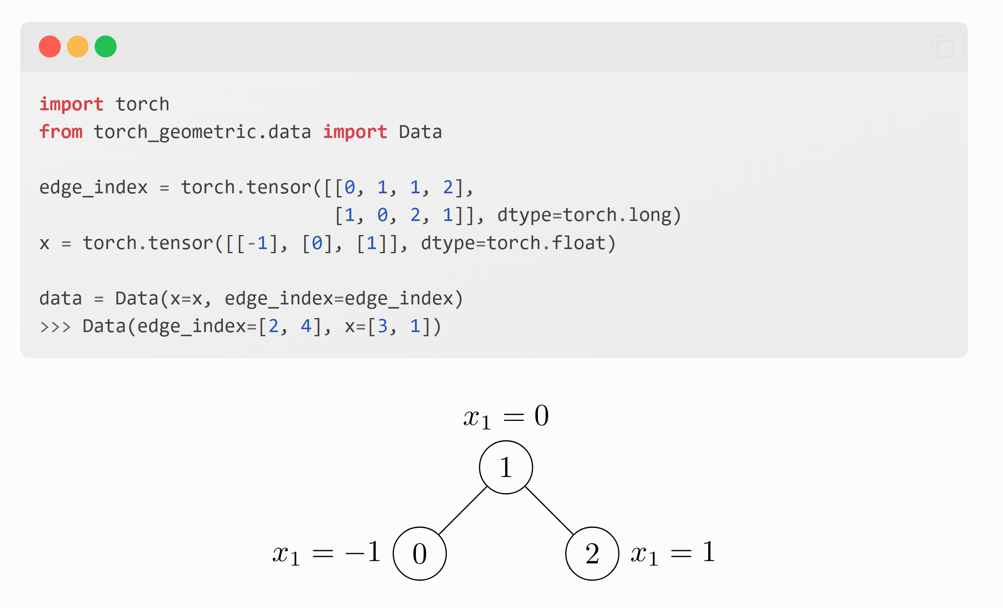
What is a Graph?

Slide 5
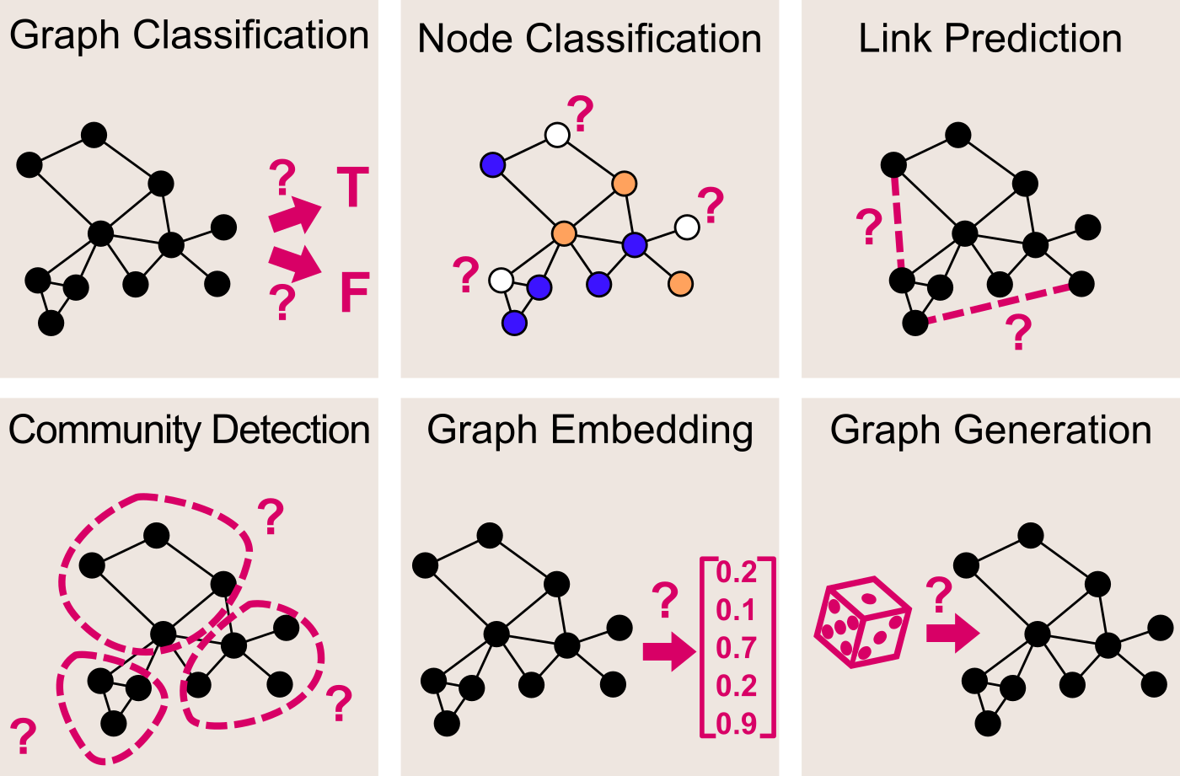

Slide 6
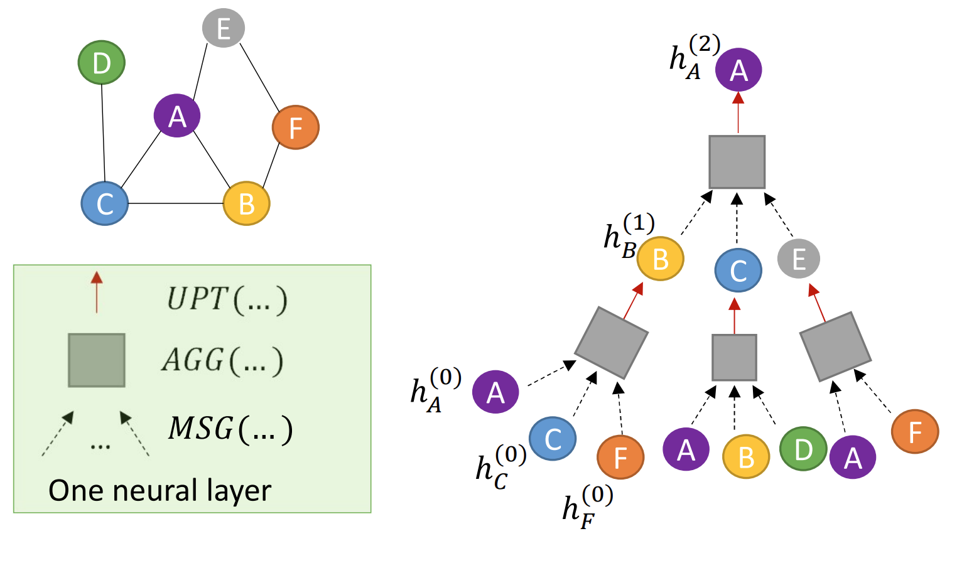
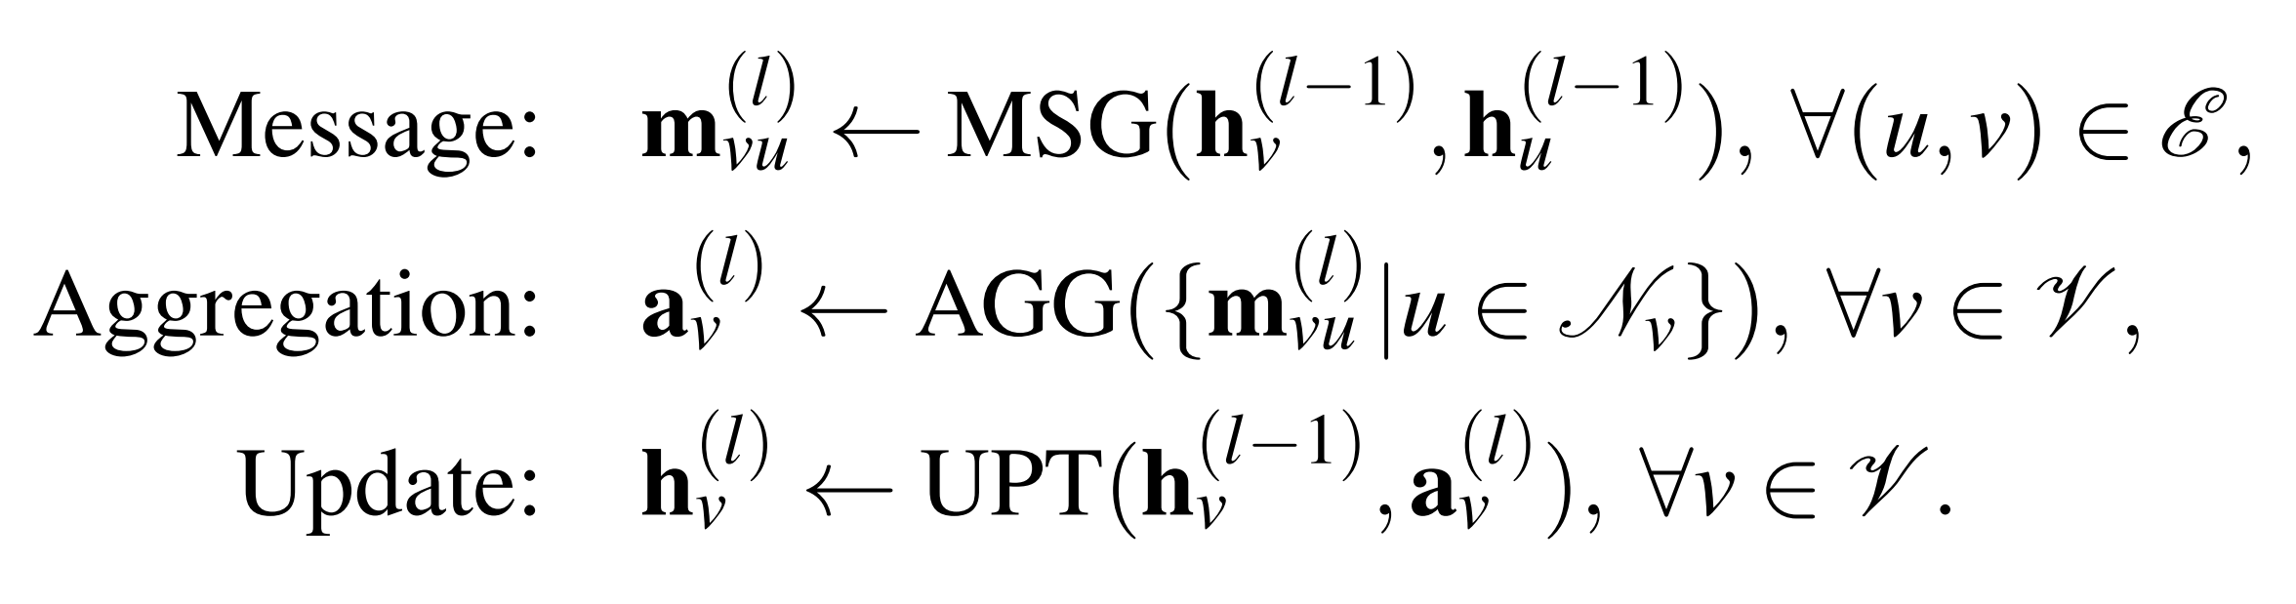
Message Passing

Slide 7
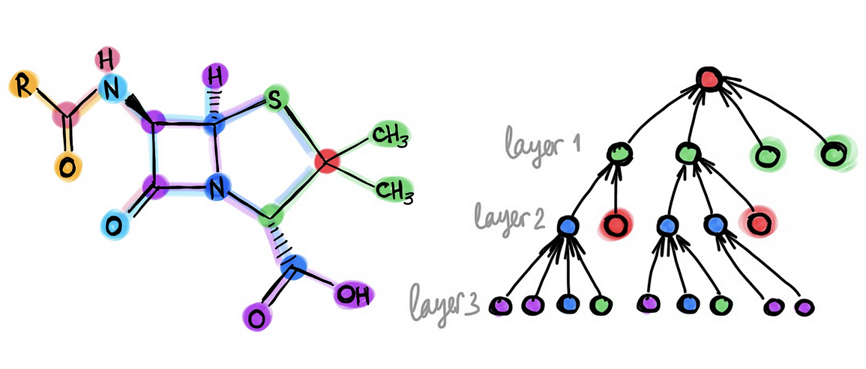
Message Passing

Slide 8



Frameworks

Slide 9
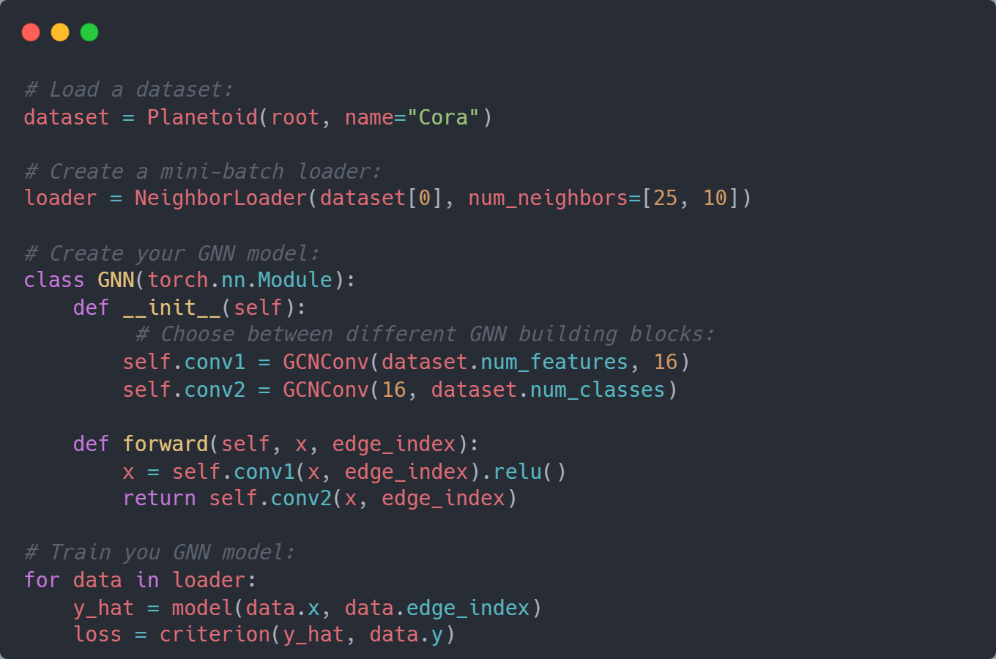
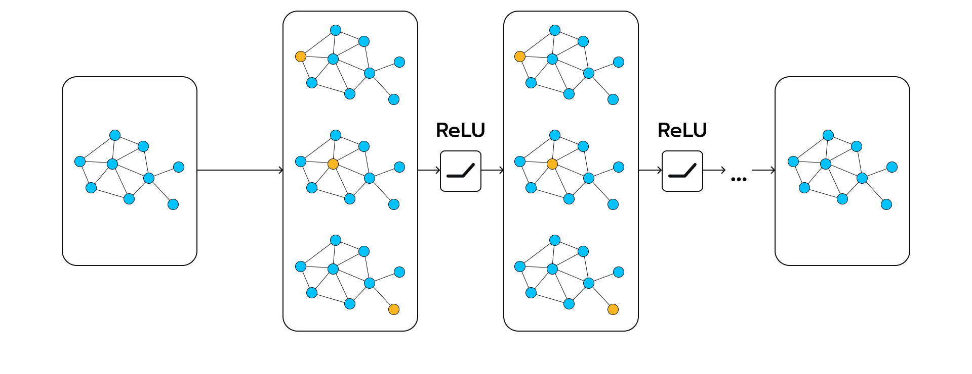
Frameworks – PyTorch Geometric

Slide 10
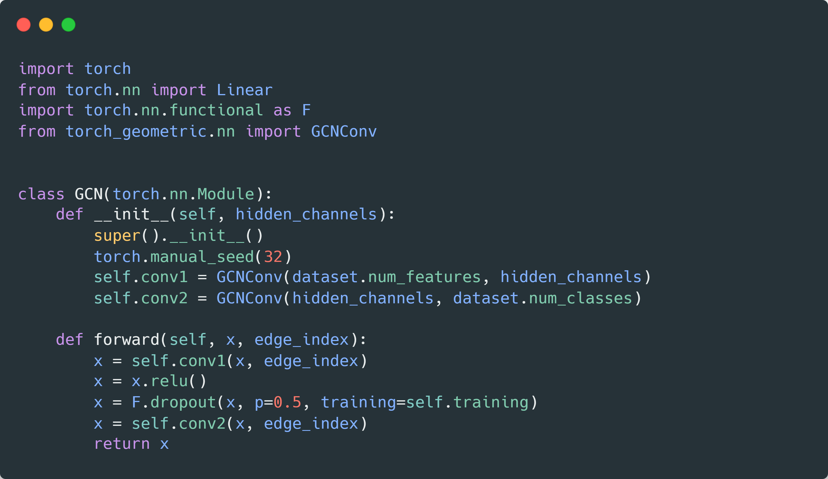
Model for node classification

Slide 11
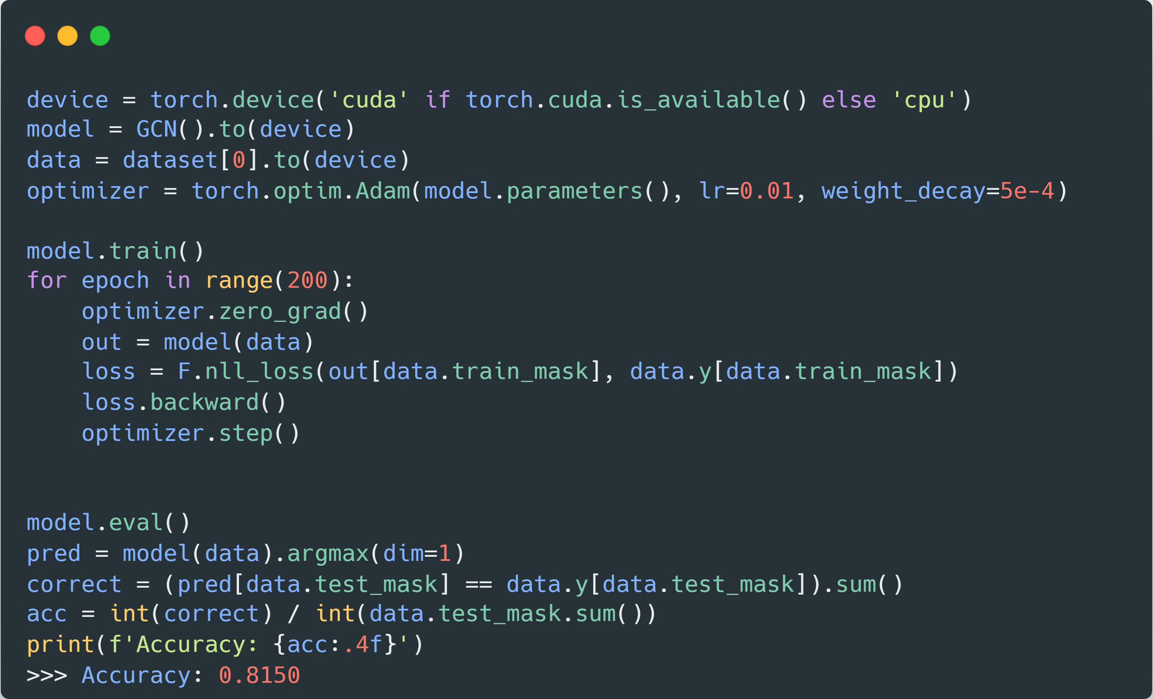
How to train a GNN for node classification?

Slide 12
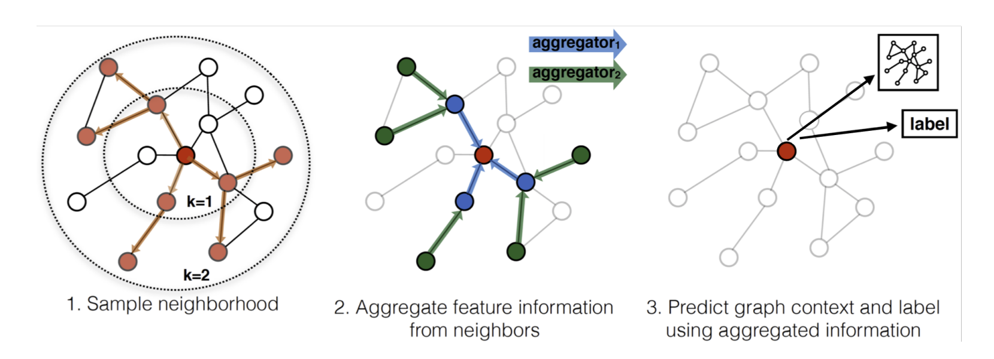
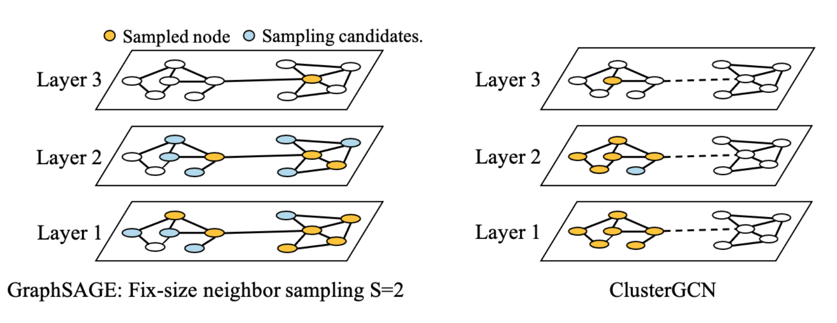
Scaling Graph Neural Networks

Slide 13
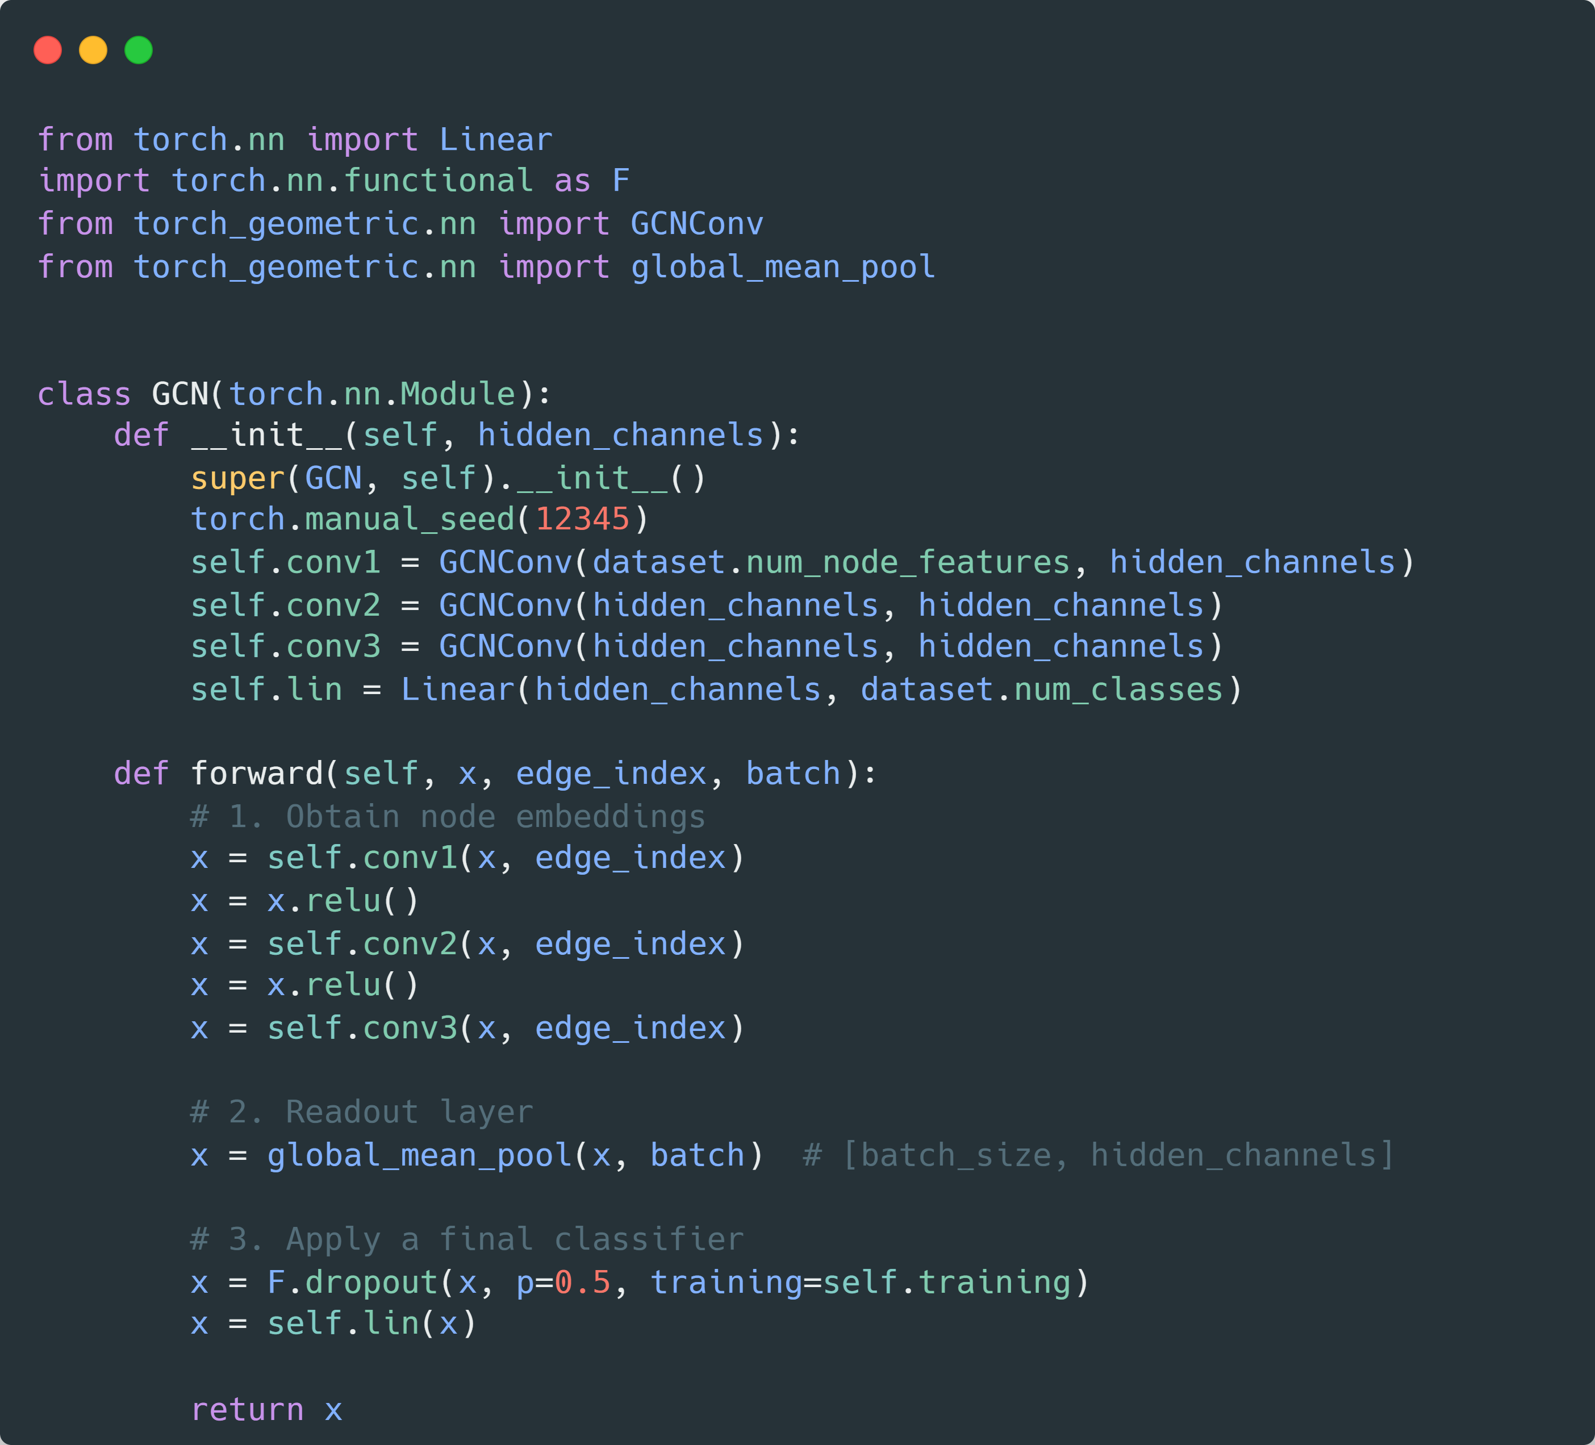
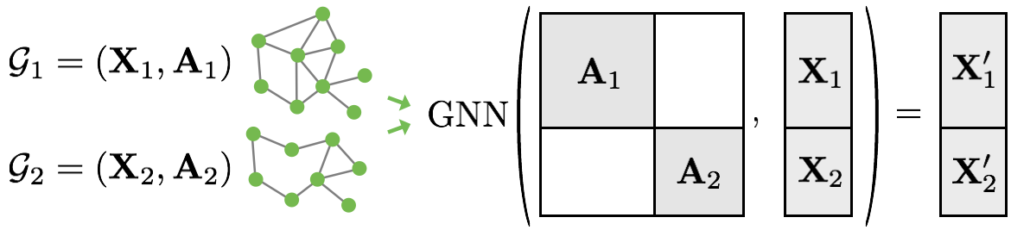
Model for graph classification

Slide 14
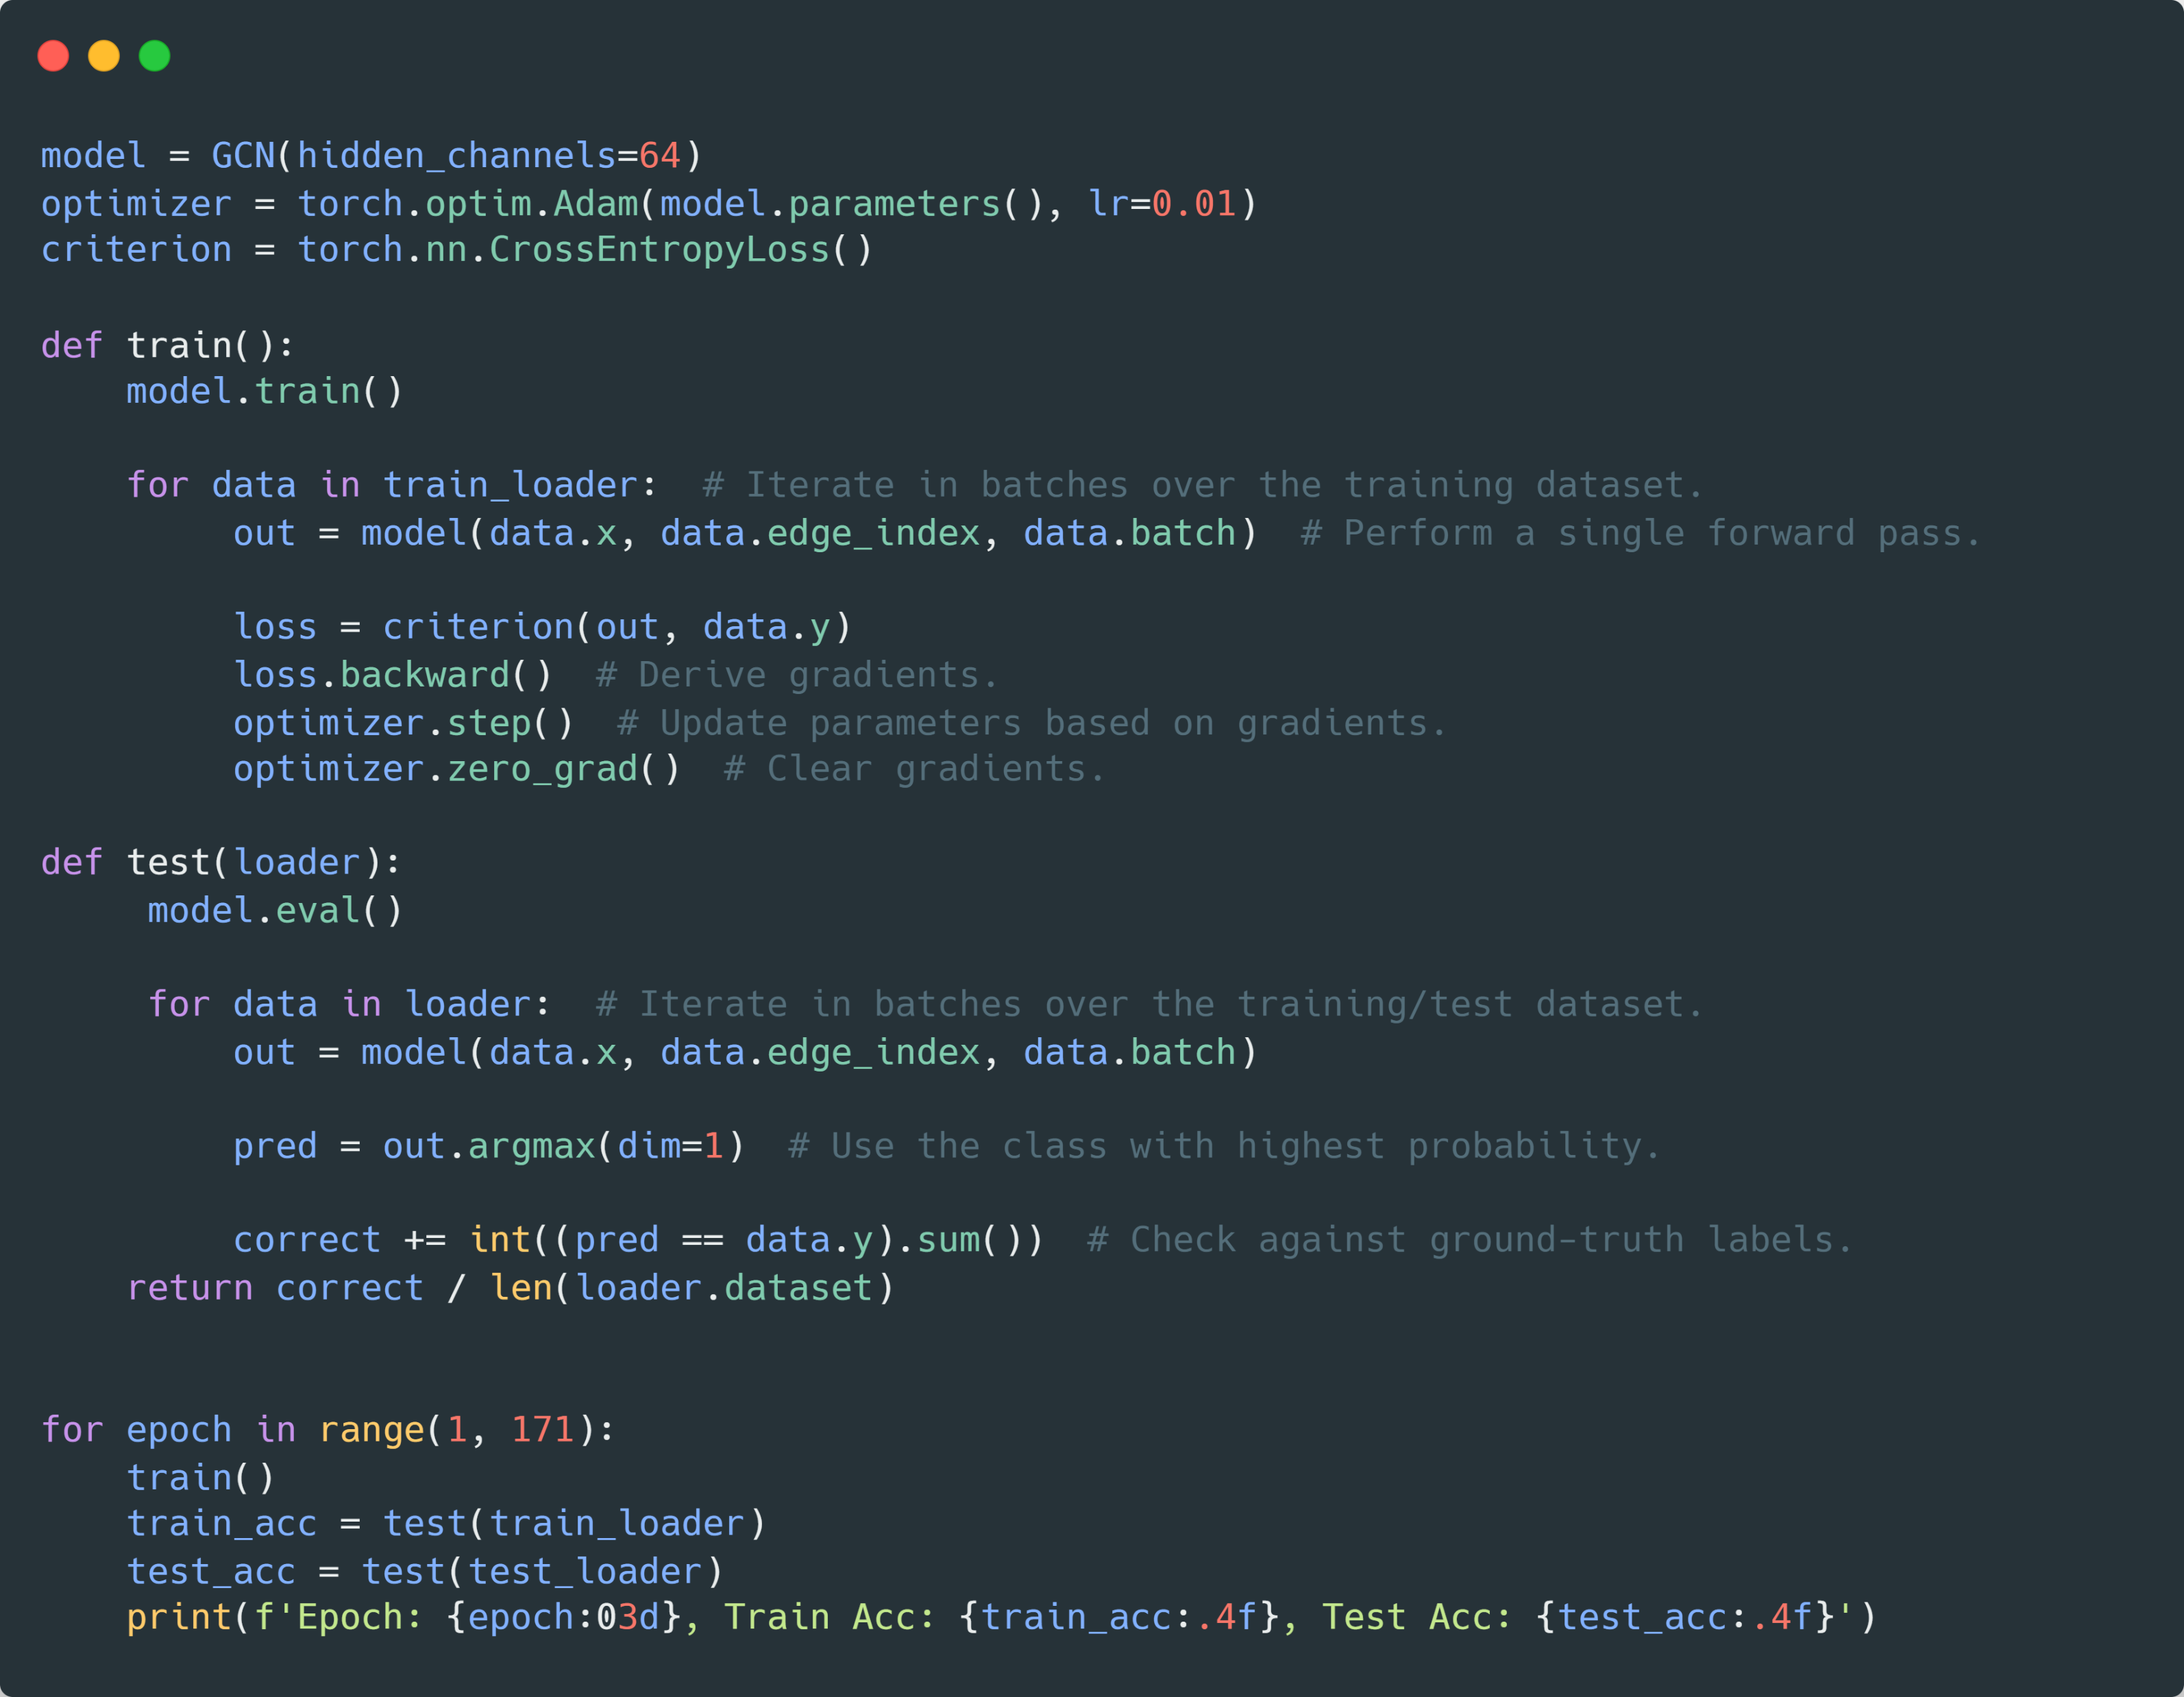
How to train a GNN for graph classification?

Slide 15
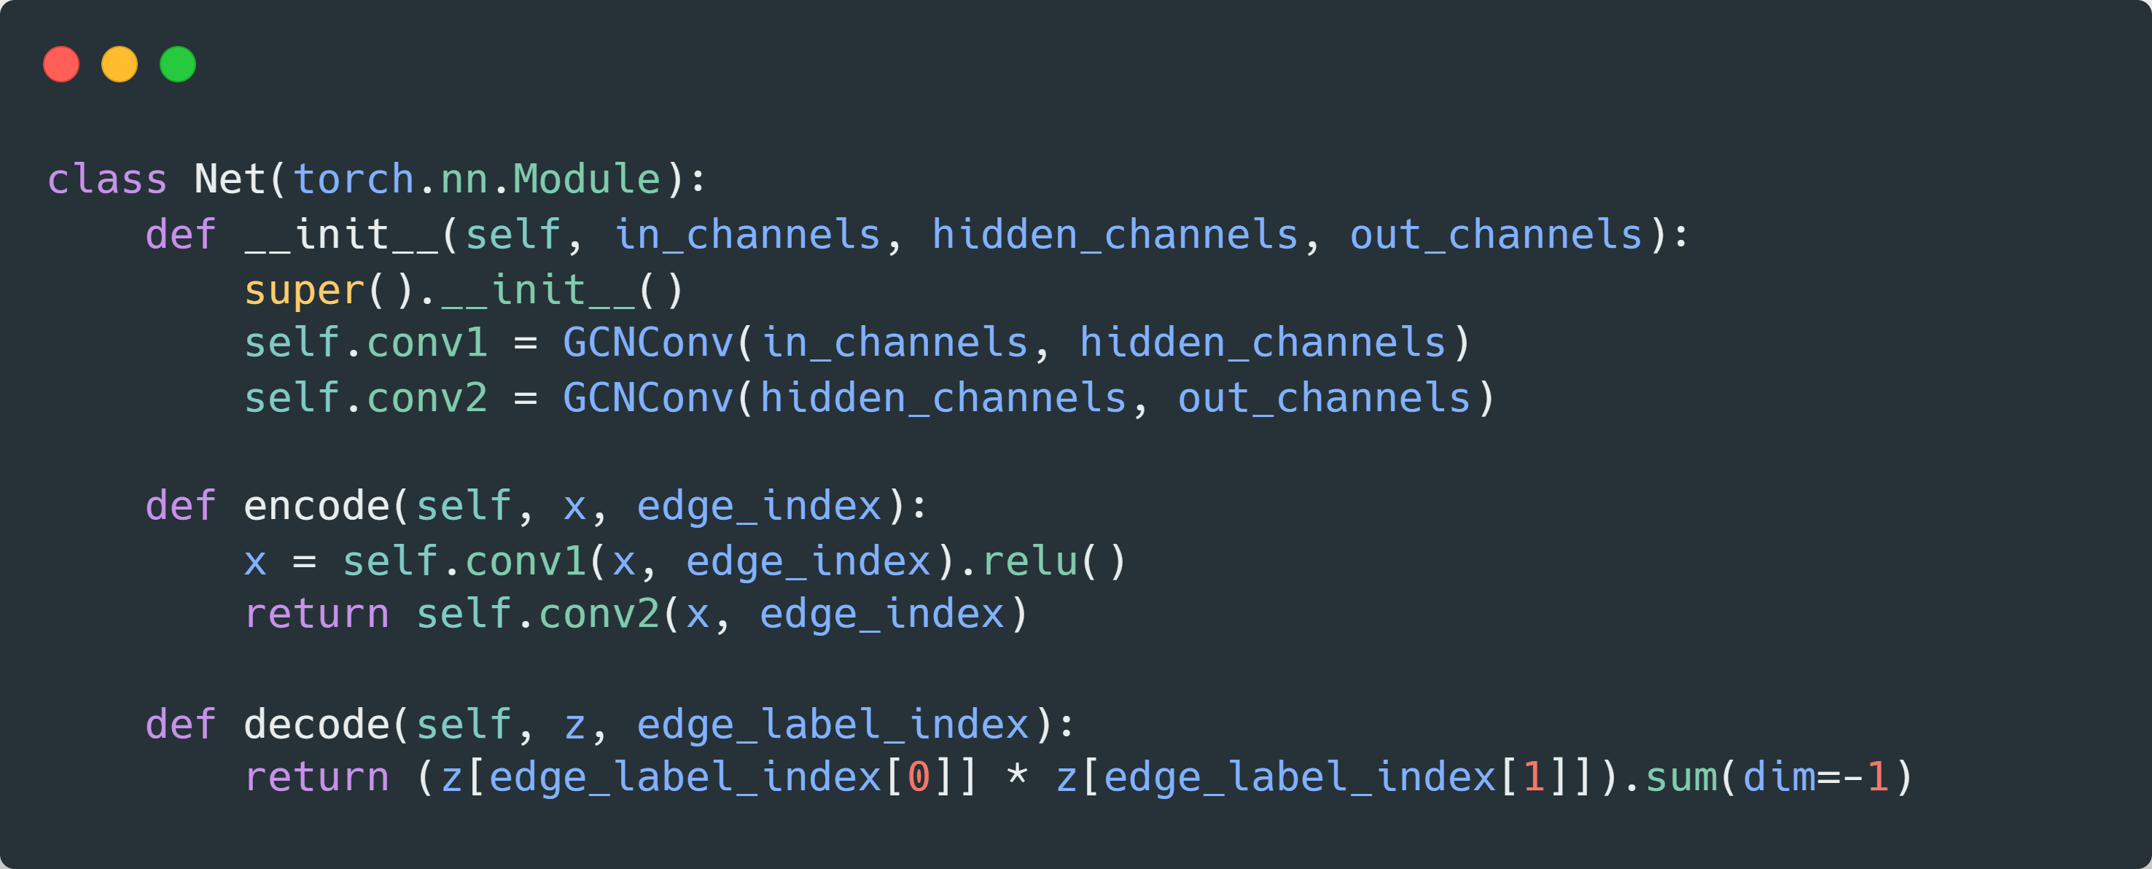
Model for link classification

Slide 16
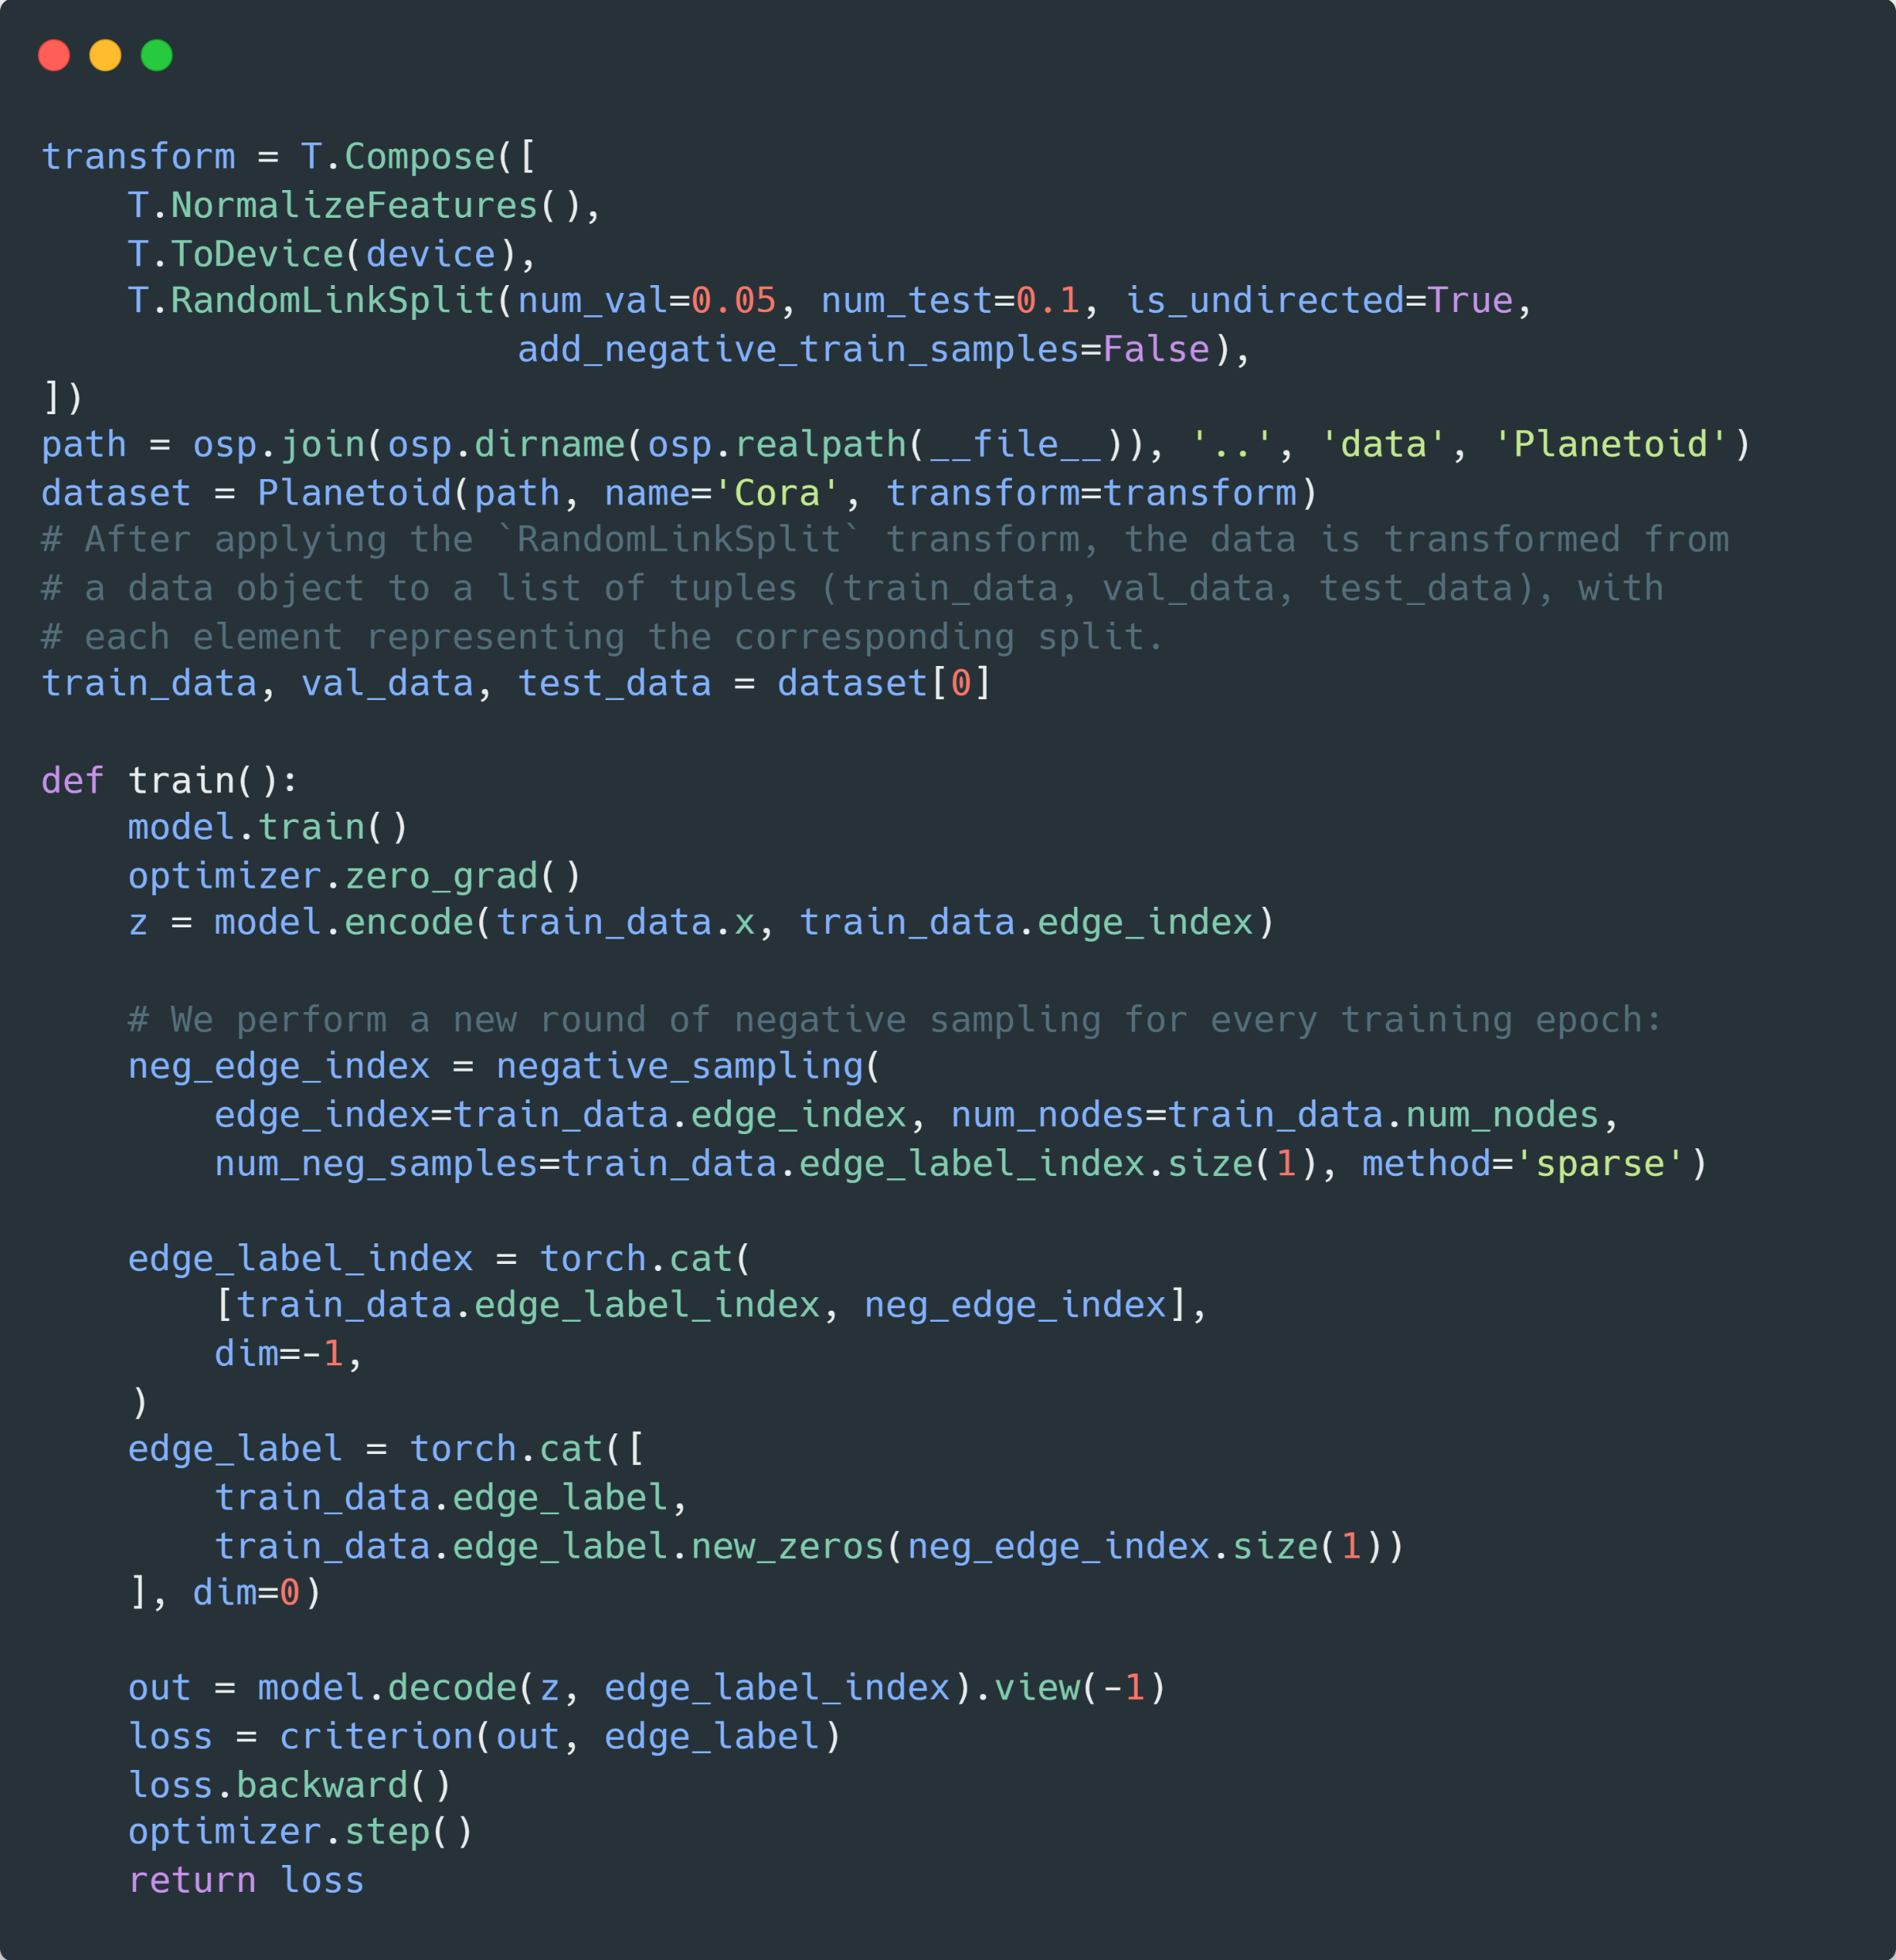
How to train a GNN for link classification?

Slide 17
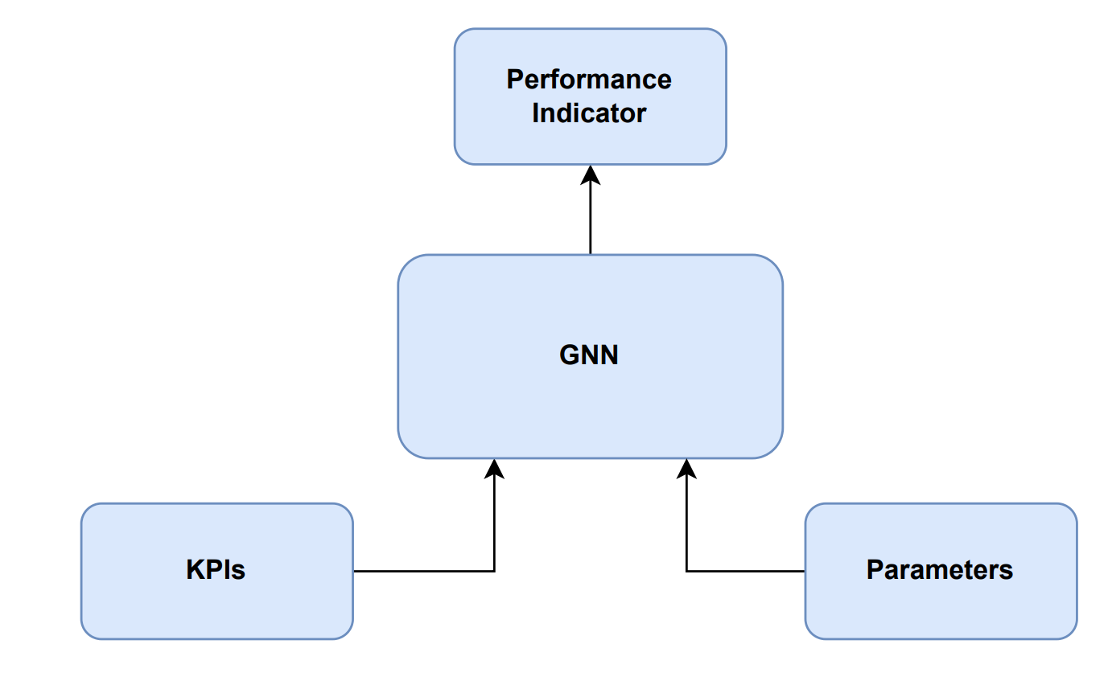

How to optimize a cellular network
Cellular Network
Solution Architecture
Optimization

Slide 18


Uplink Interference
Interference from neighbor cell
Serving eNB
Neighbor eNB
pZeroNominalPusch (p0)
Target uplink transmission power of UE
High p0 = high UE throughput, but also higher interference on neighbors
Alpha (a)
Pathloss compensation factor
High a = higher UE throughput at cell border, higher neighbor interference

Slide 19
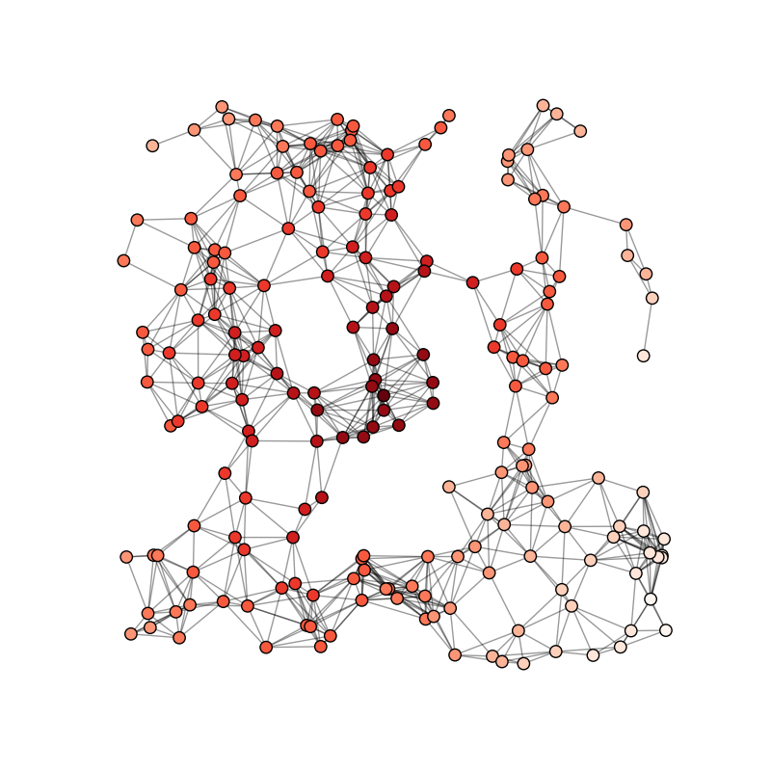
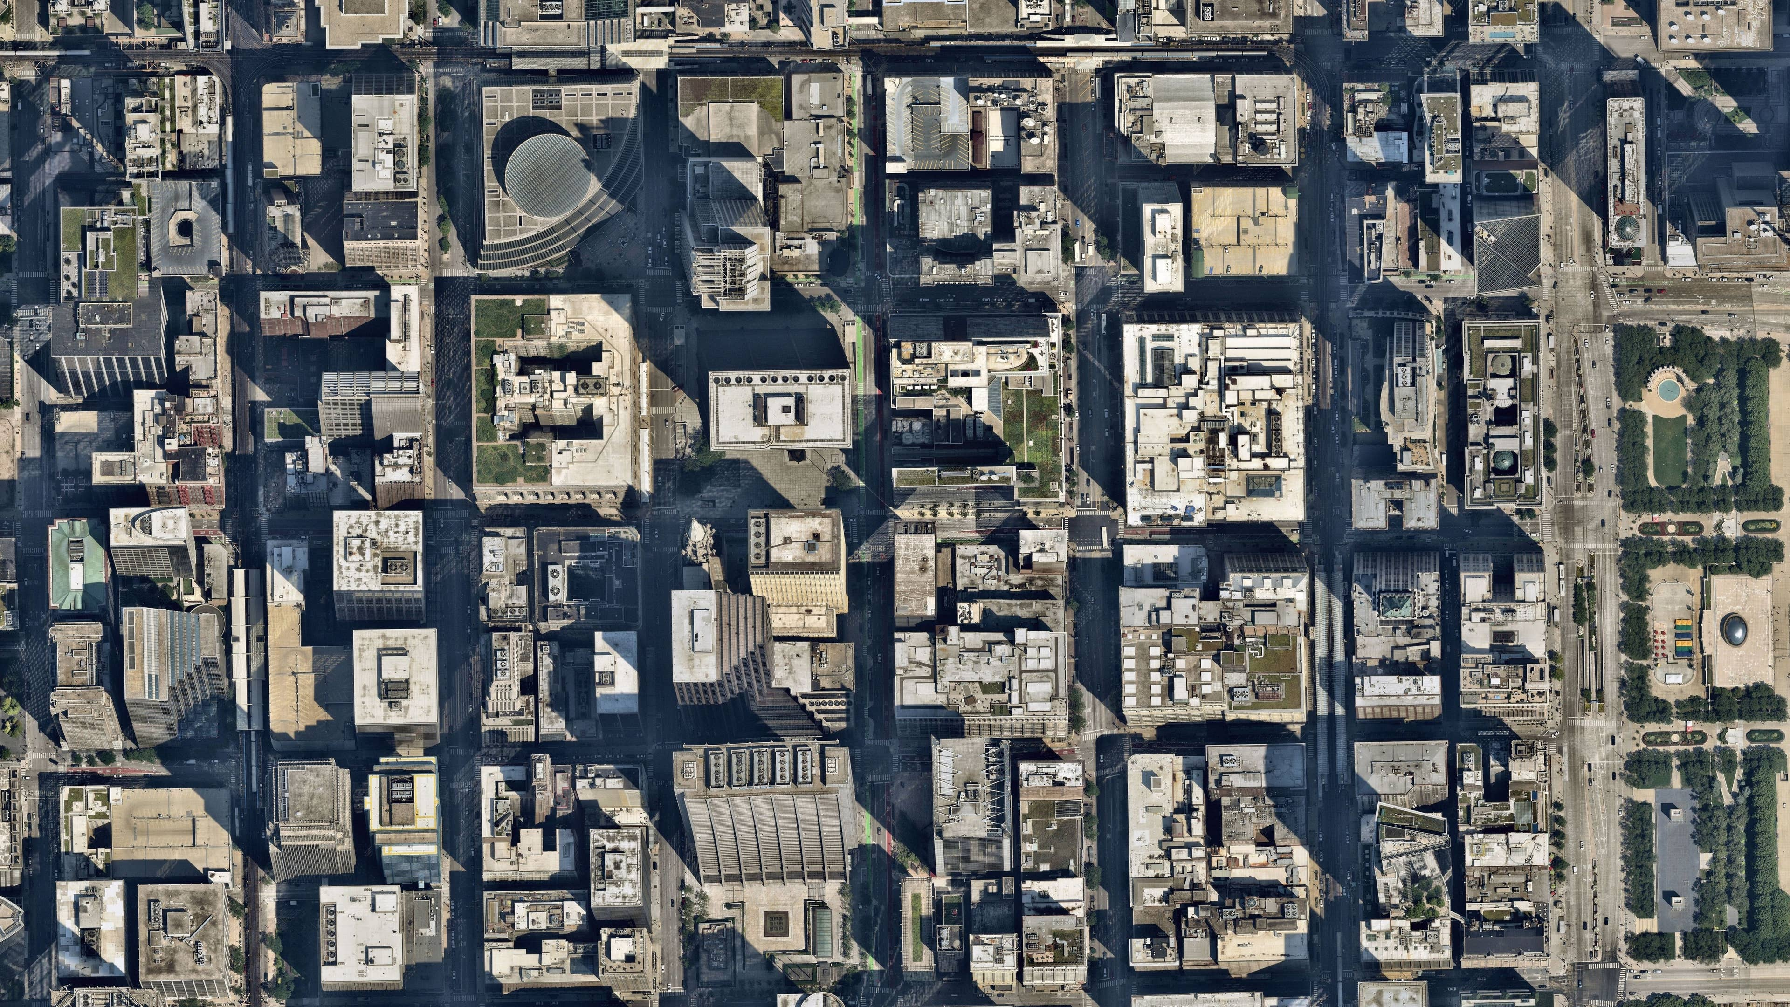
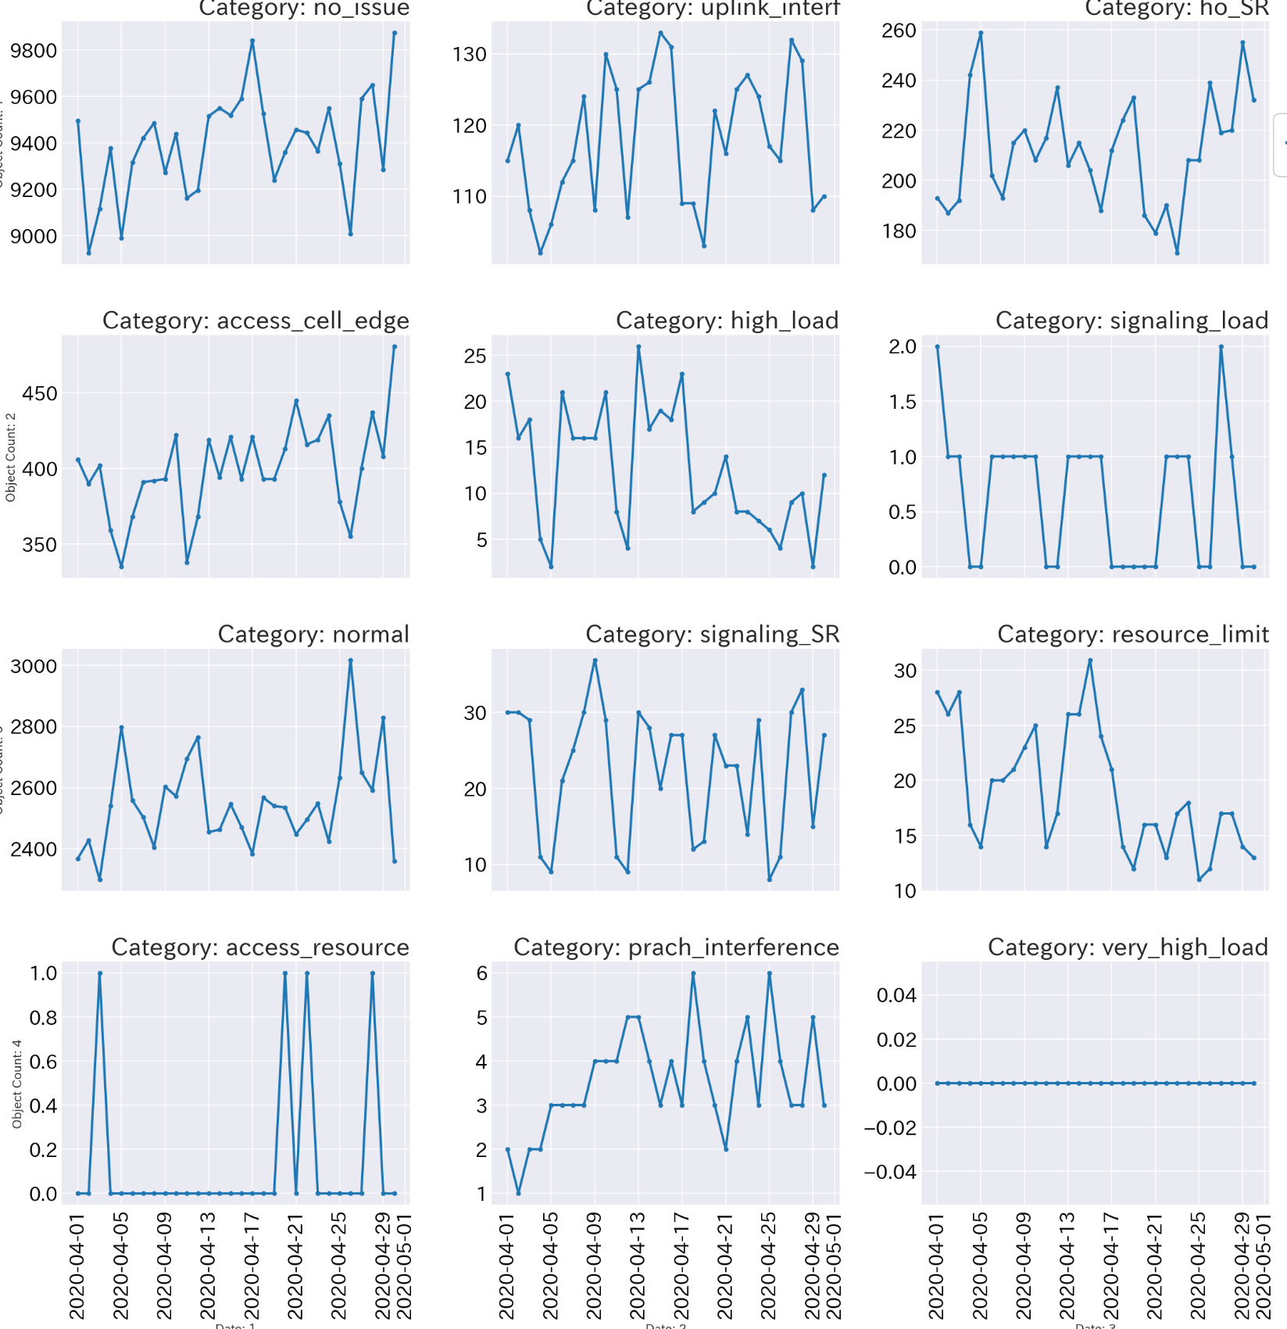
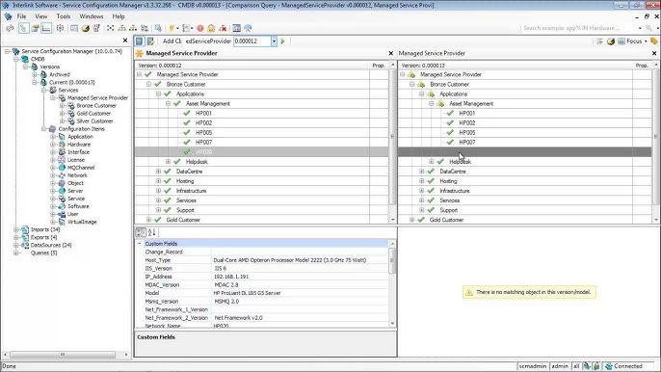


Digital Twin
Apply Graph Neural Network (GNN) to accurately model radio cellular network relations & configurations
Encode Network Data
Generic parameter framework to emulate effect on network performance indicator
Relation information:
- Physical distance
- Traffic exchanged
- Footprint overlap
- Relation parameters
Performance metrics
C
A
D
E
Configuration
F
B
Accurate modeling of real cellular network behavior
GNN architecture provides a native way of modelling cellular network interactions. The framework being developed will make the optimizer development process very straight forward and intuitive.
Digital Twin
GNN optimizer modelling enable the finding of the optimal configuration without the need of interacting with the live network by emulating radio network performance functionality from real network data

Slide 20
Test Configuration
Predicted UL SINR
(Including Performance KPIs)
1. Predict SINR with
current parameters
[-110, 8]
2. Predict SINR with
new parameters
20
[-90, 10]
18
13
Trained GNN Model
[-106, 9]
[-92, 9]
10
15
16
Issue cell
[-80, 8]
17
[-120, 10]
17
Issue cell
[-100, 10]
21
[-103, 10]
8
1. Alter power parameters
20
[-88, 9]
2. Alter power parameters until
predicted SINR is maximized
14

Slide 21
References
https://pytorch-geometric.readthedocs.io/en/latest/
https://graph-neural-networks.github.io/
https://medium.com/towards-data-science/do-we-need-deep-graph-neural-networks-be62d3ec5c59

Slide 22



